Slide 1
Swarm Intelligence
For Smart Surveillance and Emergency Response
By - Kunal Yadav [ A7605221184 ] Sanjana Yadav [ A7304821038 ]

Slide 2
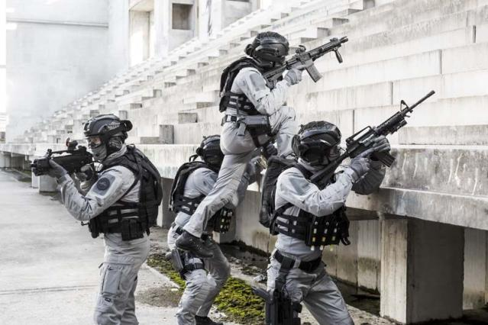
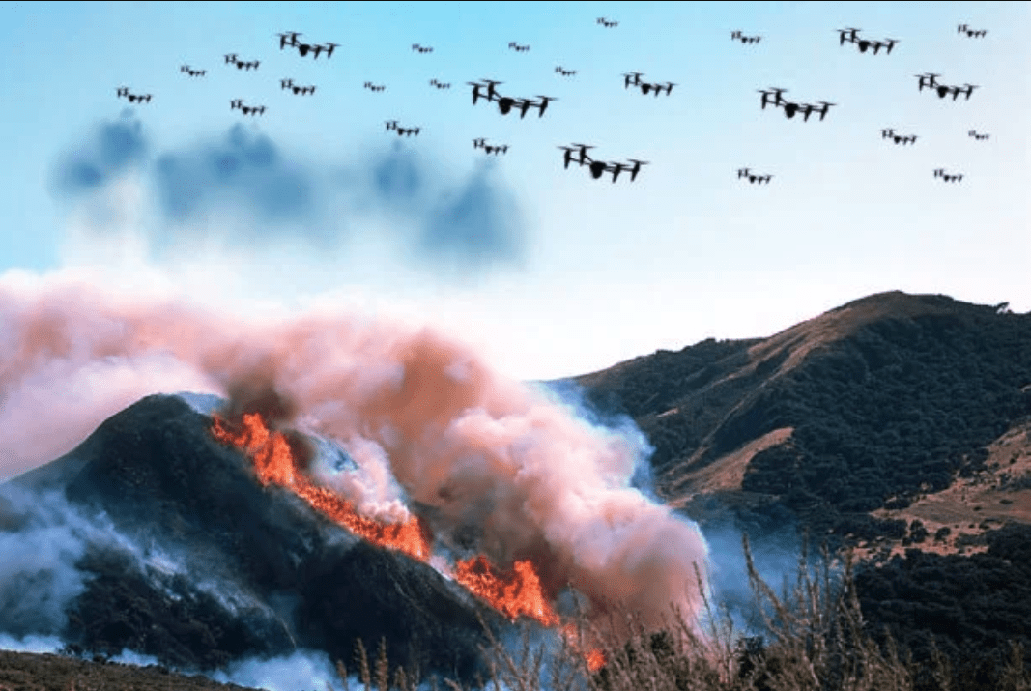
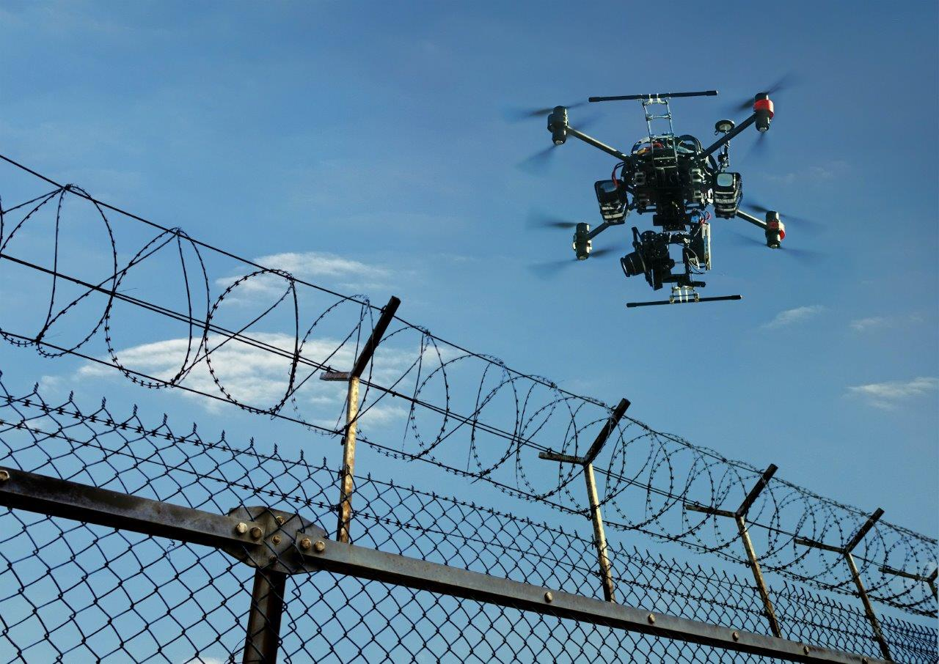
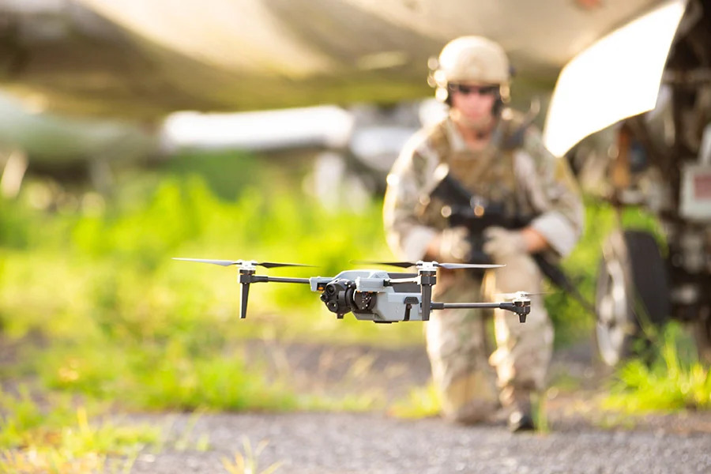
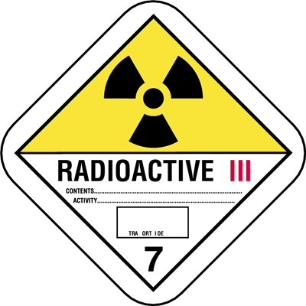
Emergency response require extensive knowledge of the crisis area and up-to-date information on structures, road access, victims location and new threats. Collecting and sharing this information is challenging, especially in a hostile environment where there is often no reliable network infrastructure.
Problem Statement

Slide 3
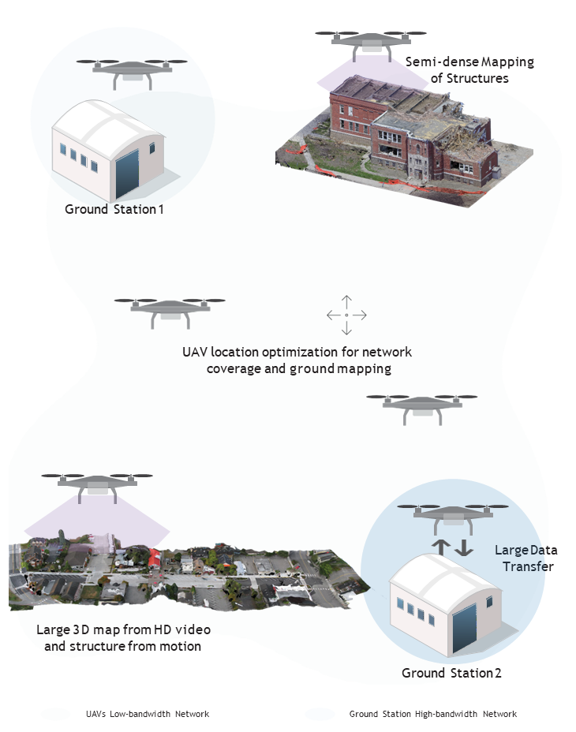
Proposed Solution
Mobile Ad-Hoc off-grid network
Smart UAV swarm autonomy
Intuitive UAV swarm control interface
Cartography from multiple UAVs
Drone data muling
Drone extended network coverage
Onsite/ Expert Support
Human Pilot
Integrated system
Bots/UAVs

Slide 4
Characteristics of Swarm
Scalability: A good swarm defense system should be scalable to handle a large number of sensors, nodes, and agents. The system should be capable of processing large amounts of data and adapting to changing conditions.
Resilience: A good swarm defense system should be resilient to attacks, disruptions, and failures. The system should be designed to operate in a degraded or disrupted environment and continue to provide critical services.
Adaptability: A good swarm defense system should be adaptable to changing conditions and threats. The system should be capable of learning and evolving over time to improve its performance.
Distributed: A good swarm defense system should be distributed, with multiple sensors, nodes, and agents operating in a coordinated manner. The system should be designed to operate in a decentralized manner, with each node contributing to the overall defense capability.
Real-time: A good swarm defense system should provide real-time detection, tracking, and response capabilities. The system should be capable of processing data and providing alerts and responses in real-time to enable timely and effective defense.
Robust: A good swarm defense system should be robust to noise, false positives, and other sources of error. The system should be designed to filter out noise and false positives and provide accurate and reliable information to enable effective decision-making.
Privacy and Security: A good swarm defense system should be designed with privacy and security in mind. The system should protect the privacy of individuals and ensure the security of the data and information collected and used by the system.

Slide 5
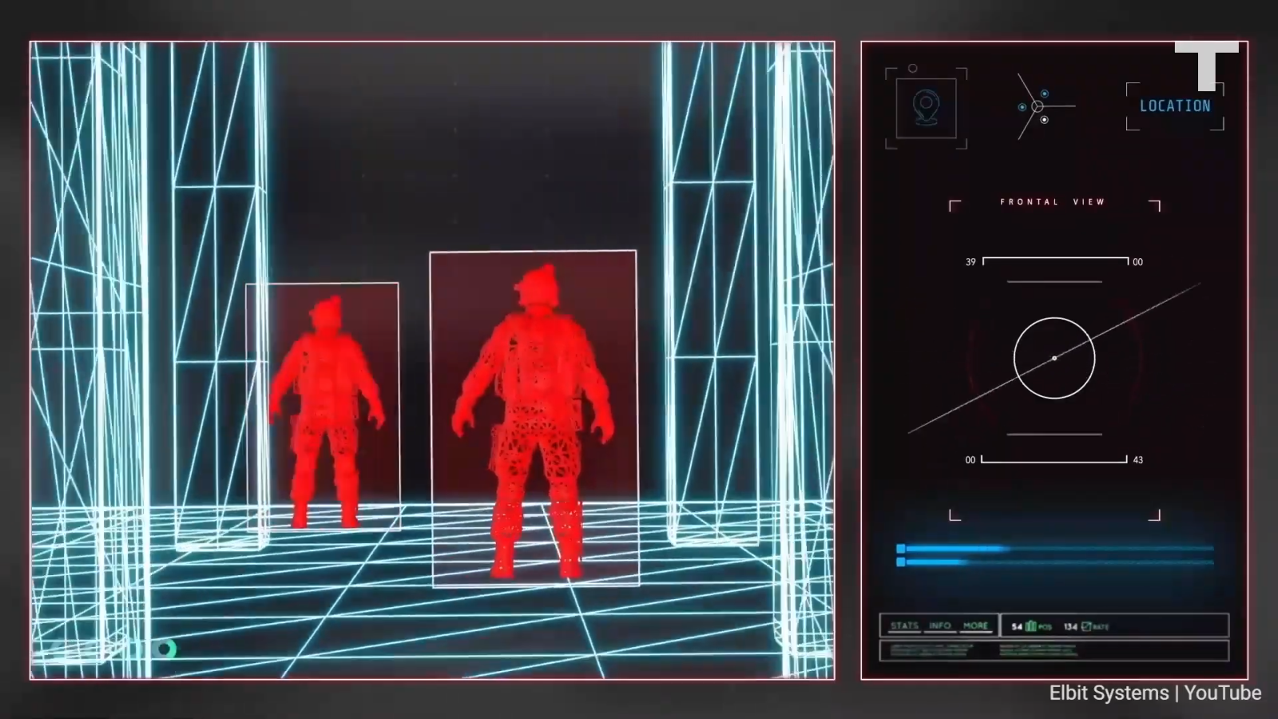
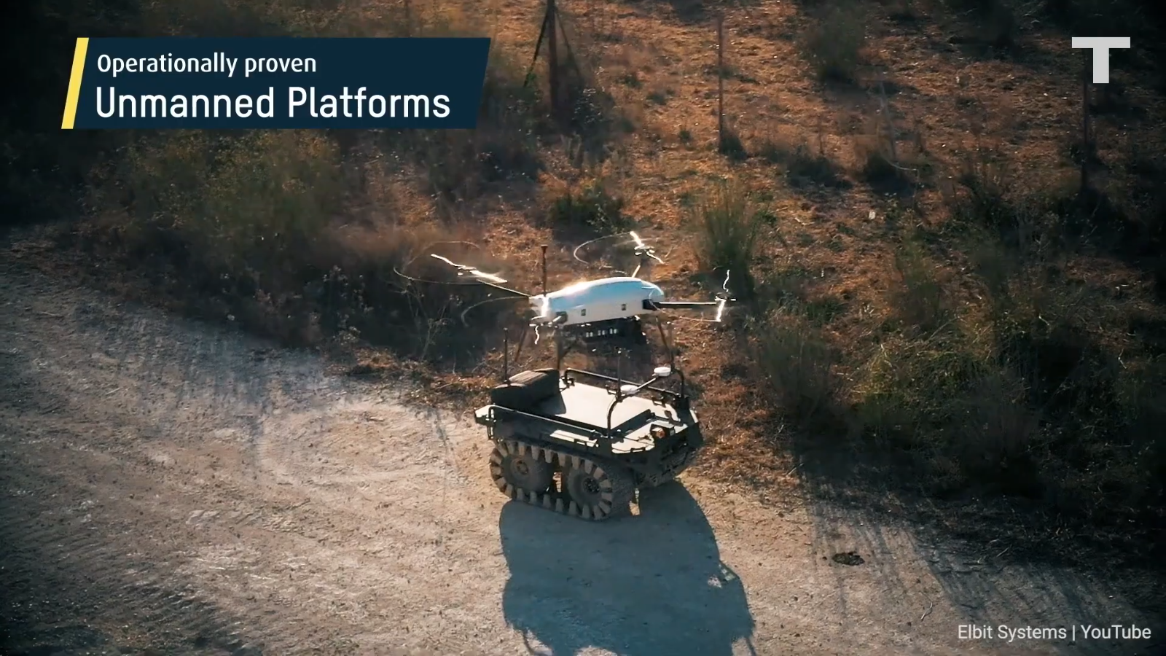
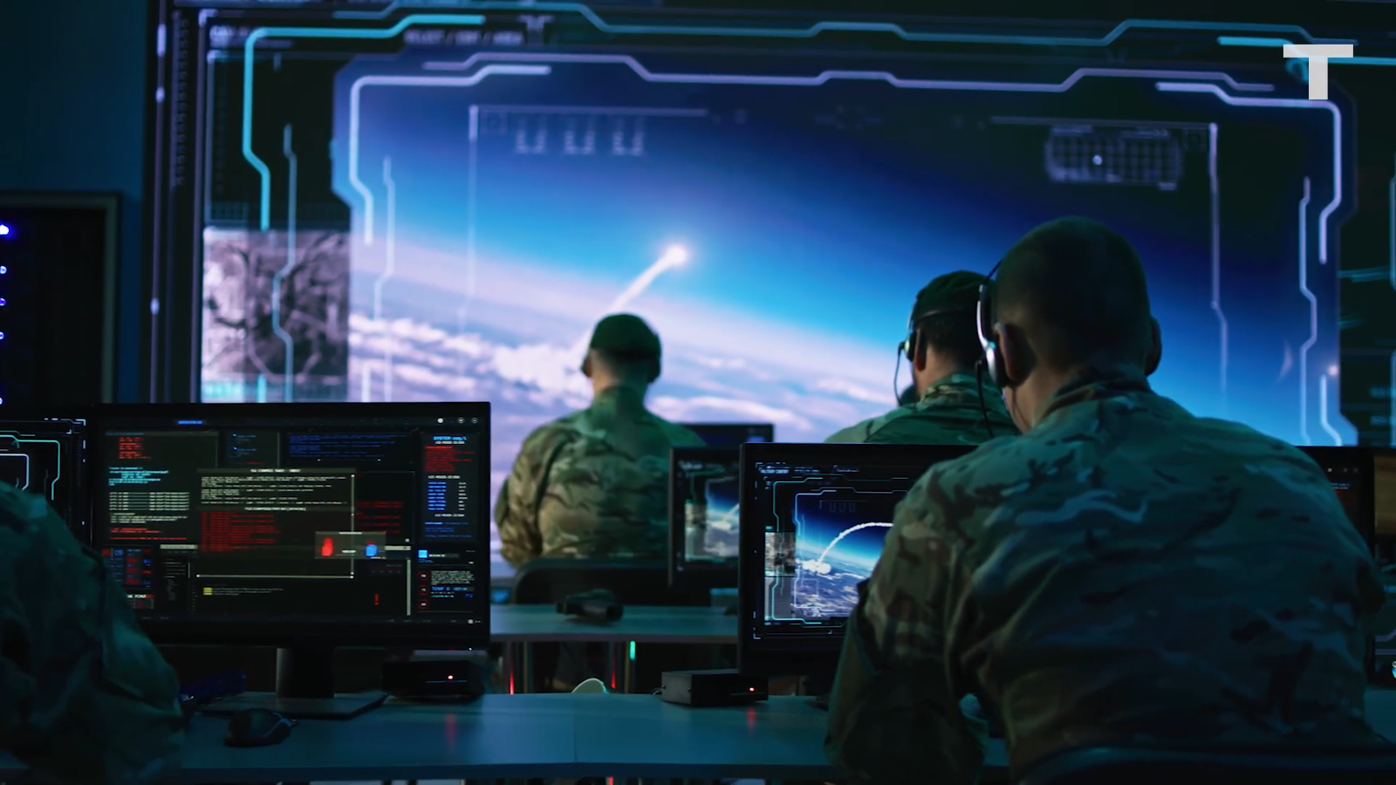
Improve Situation Awareness
• Short-range high-bandwidth network
• Long-range low-bandwidth network
• ROS-based onboard embedded platform
• Network coverage optimisation algorithm
• Collision avoidance and GPS navigation
• Point-cloud sensors (stereo or laser)
• Hd cameras on gimbal
Increased accuracy
Why Swarm?
Cost Effectiveness
Flexibility

Slide 6
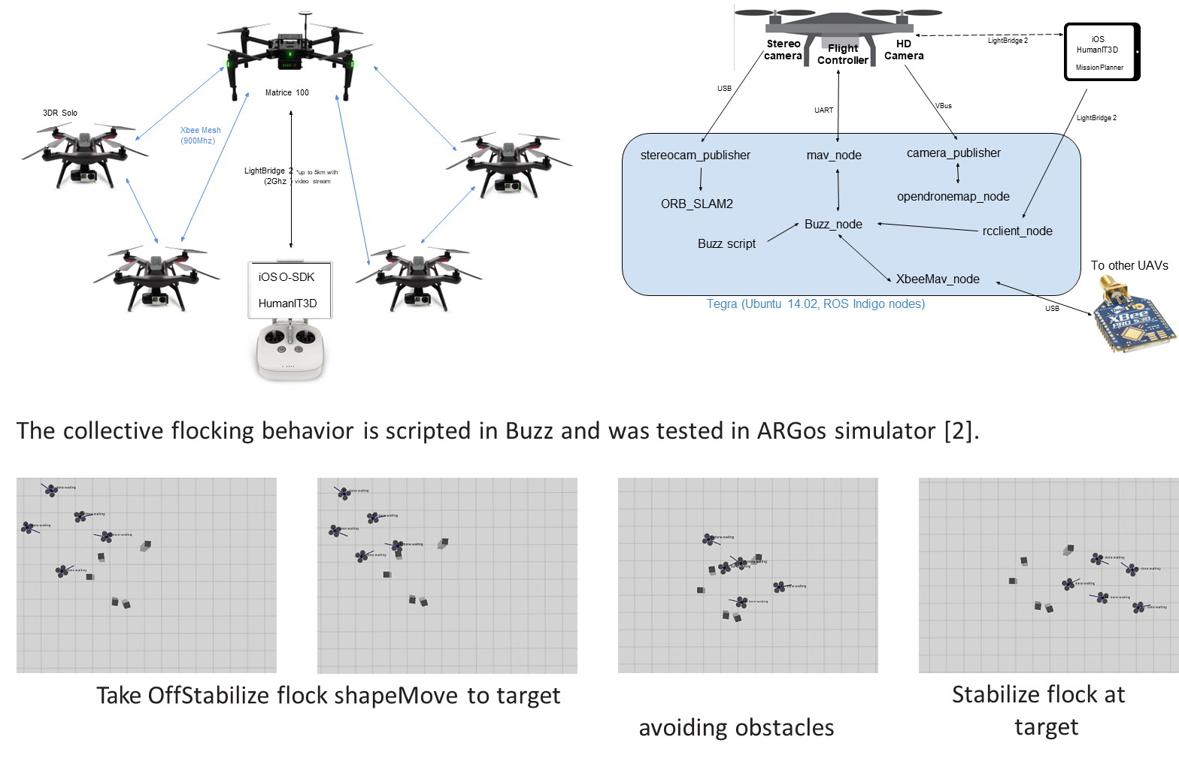
Diagrammatic Representation
And
Functioning
In upcoming slid we see the present scenario of UAV swarm and future expectations…

Slide 7
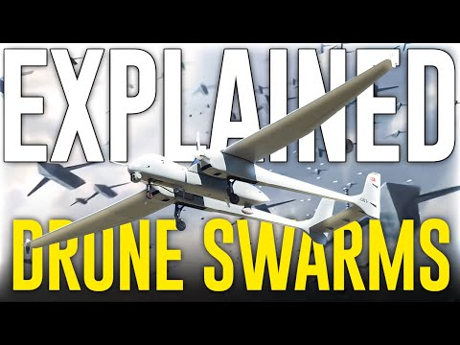

Slide 8
Increased Automation
With advances in artificial intelligence and machine learning, smart surveillance systems using swarm intelligence may become more automated, with the ability to make decisions and take actions in real-time.
Improved Accuracy
As swarm algorithms continue to improve, smart surveillance systems using swarm intelligence may become more accurate in detecting and tracking unauthorized border crossings and other threats.
Integration with other Technologies
Smart surveillance systems using swarm intelligence may be integrated with other technologies, such as unmanned aerial vehicles (UAVs), satellite imagery, and ground sensors, to provide a more comprehensive and effective border security solution.
Enhanced privacy & ethical safeguards
As concerns around privacy and ethical issues continue to be addressed, smart surveillance systems using swarm intelligence may incorporate more robust privacy-enhancing technologies and transparent governance structures to ensure responsible use.
Greater efficiency & cost-effectiveness
As smart surveillance systems using swarm intelligence become more mature and widely adopted, they may become more efficient and cost-effective, with the potential to reduce the need for human resources and infrastructure.

